Slide 1







@RLadiesMelb
Development of Depth-Dependent Binocular Visual Fields Simulation and Visualization package.
Dr Virginia Liu
12th May 2020
Notes:
https://us02web.zoom.us/j/82809183323
"I would like to acknowledge the Wurundjeri (wa-RUN-dja-ree.) people of the Kulin nation who are the traditional custodians of the land on which Melbourne campus stands.
I would also like to pay respect to the Wurundjeri Elders, past and present, and extend this respect to Aboriginal and Torres Strait people from other communities who are here today ".

Slide 2
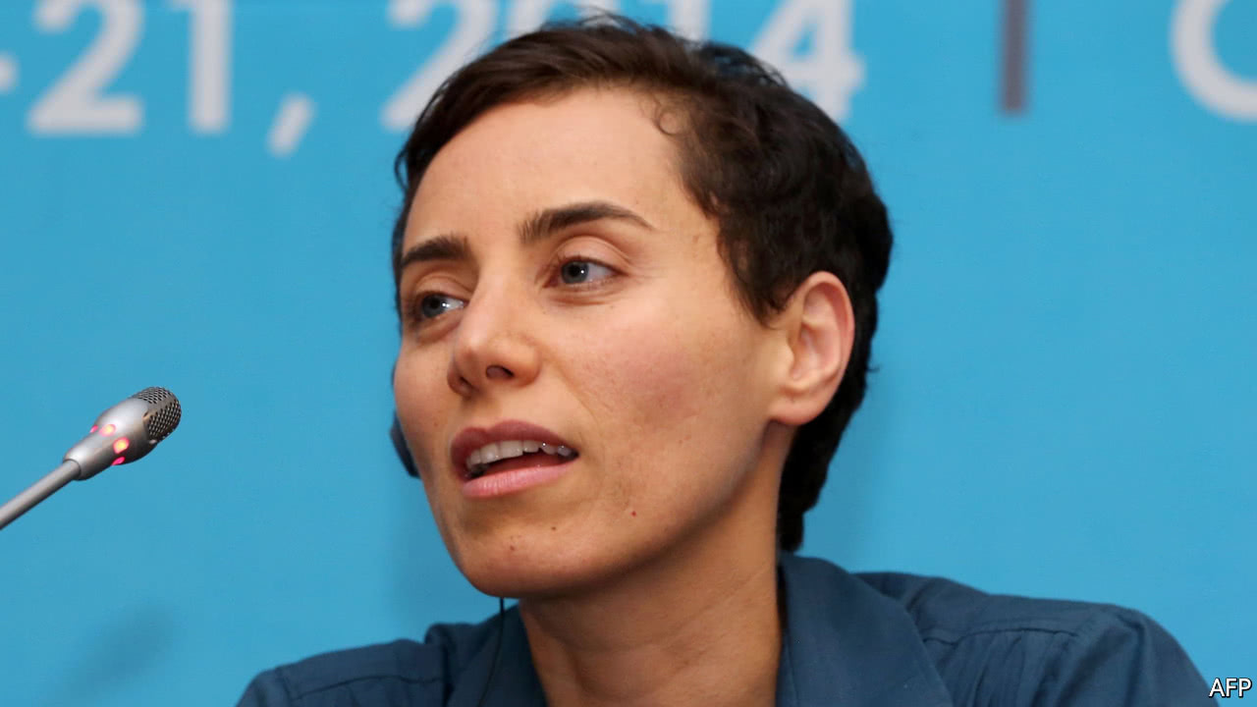
Women In Mathematics Day
Notes:
May 12th is a joyful opportunity for the mathematical community to celebrate women in mathematics. The celebration takes place every year, all around the world. Why May 12th?
The goal of the day is to inspire women everywhere to celebrate their achievements in mathematics, and to encourage an open, welcoming and inclusive work environment for everybody.
How does it work?
The May 12th initiative brings together virtual or local events celebrating women in mathematics which take place during the month of May.
May 12th, 1977, is the birthdate of Maryam Mirzakhani.
Who is Maryam Mirzakhani?
Maryam Mirzakhani was an Iranian mathematician and a Professor of Mathematics at Stanford University. She was one of the world’s leading experts in geometry and dynamical systems. Her beautiful and astonishing results and her life and career are an inspiration for everyone, women and men, to pursue their dreams in science. She died tragically from cancer in 2017 at the early age of 40.
In 2014, Maryam Mirzakhani was awarded the Fields Medal for her outstanding contributions to the dynamics and geometry of Riemann surfaces and their moduli spaces, becoming the first woman, and the first Iranian, to be recognised for her mathematical achievements by this top mathematical prize.
In the few interviews she gave, Mirzakhani spoke eloquently of the beauty of mathematics and her joy in doing it.
12th May, her birthday, was chosen to celebrate Women in Mathematics in her memory.

Slide 3

We are still here

Slide 4
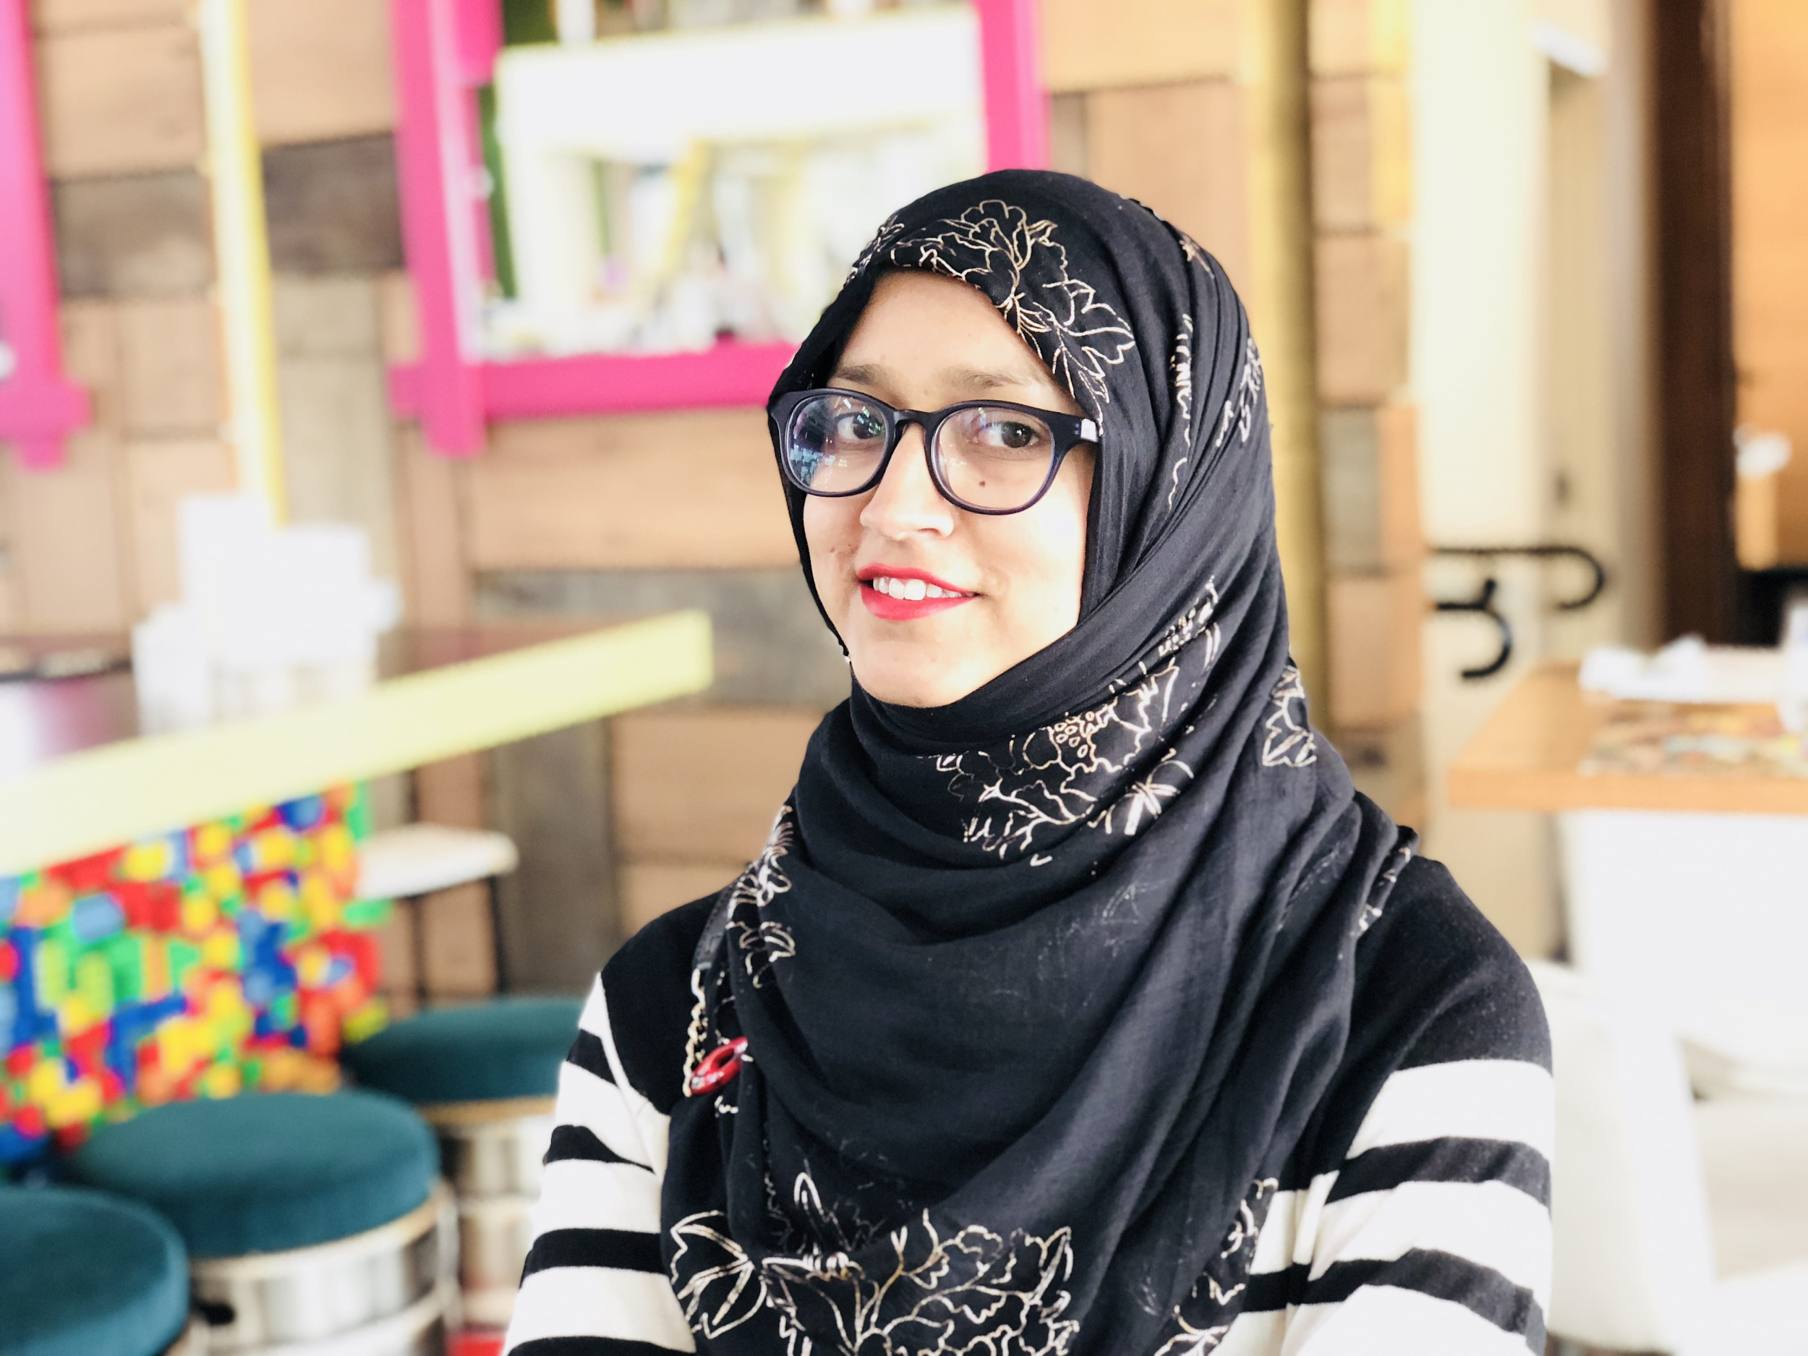
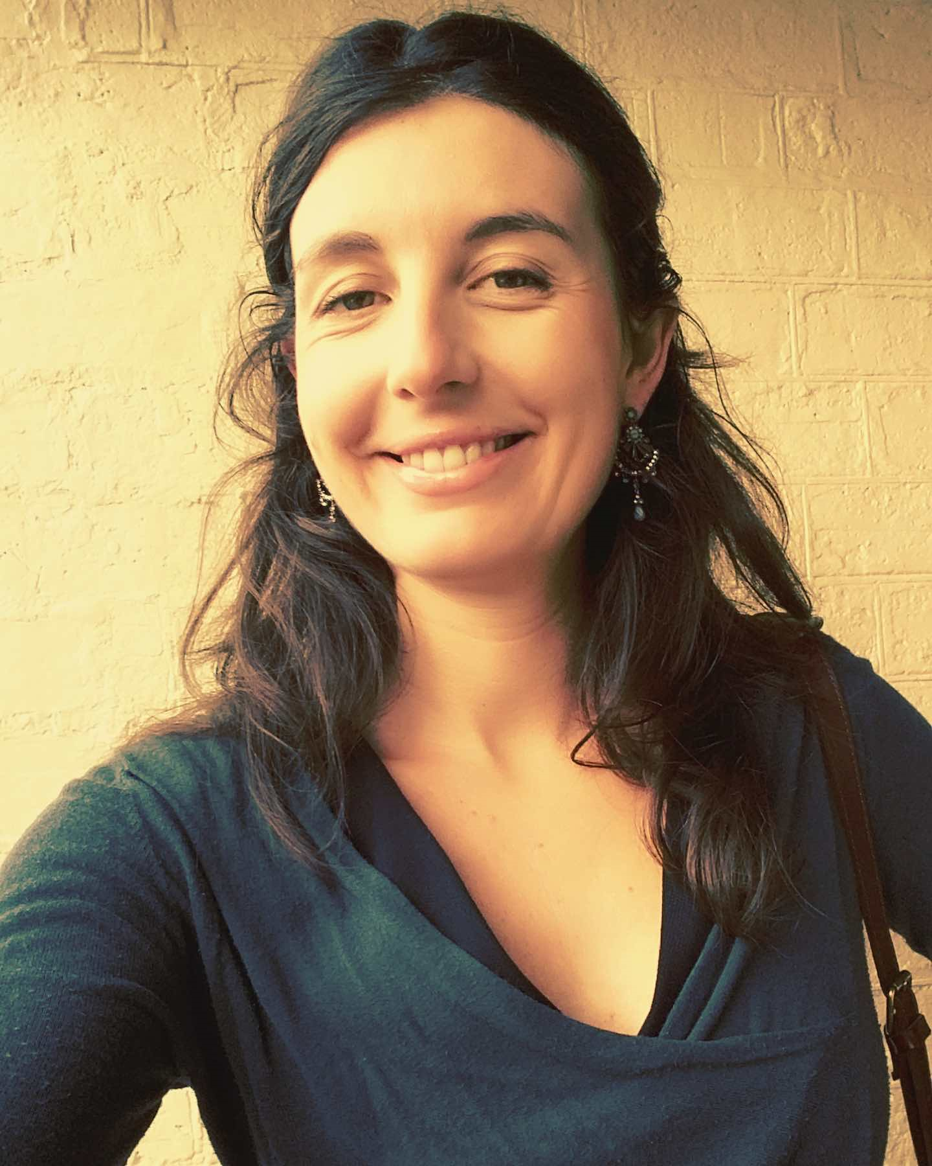
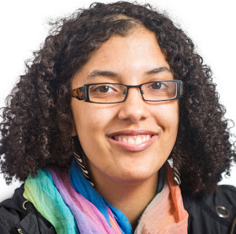
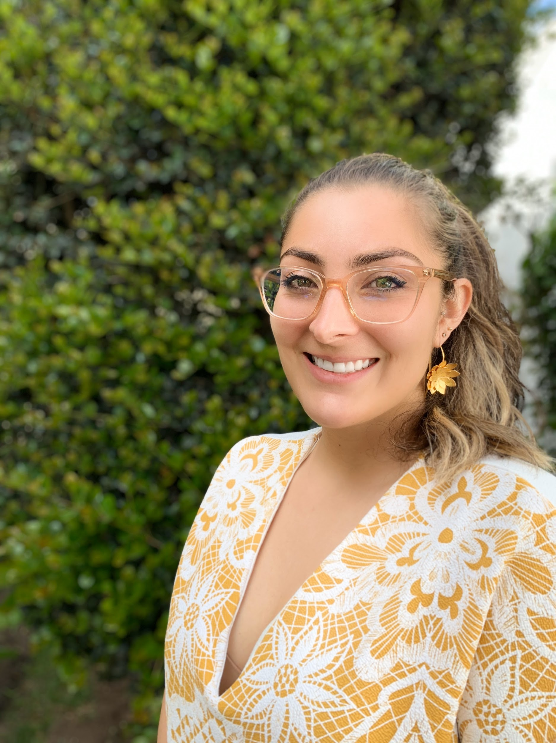
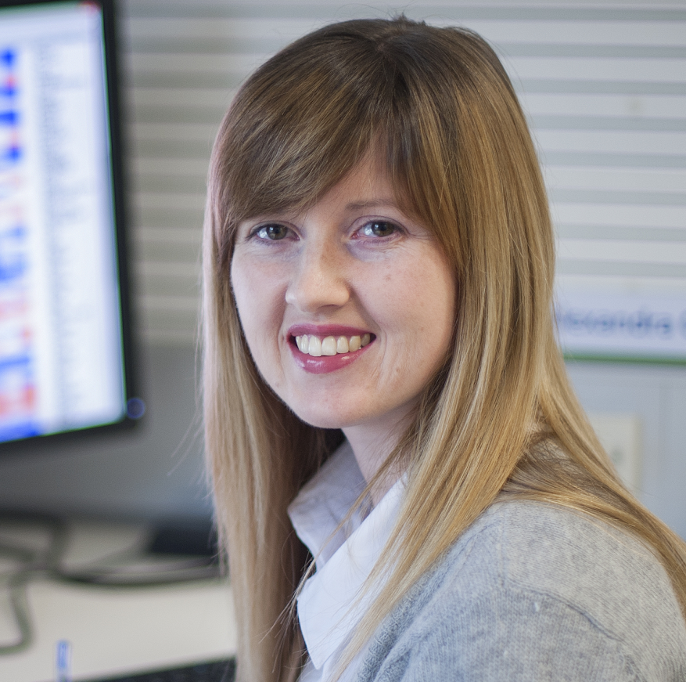
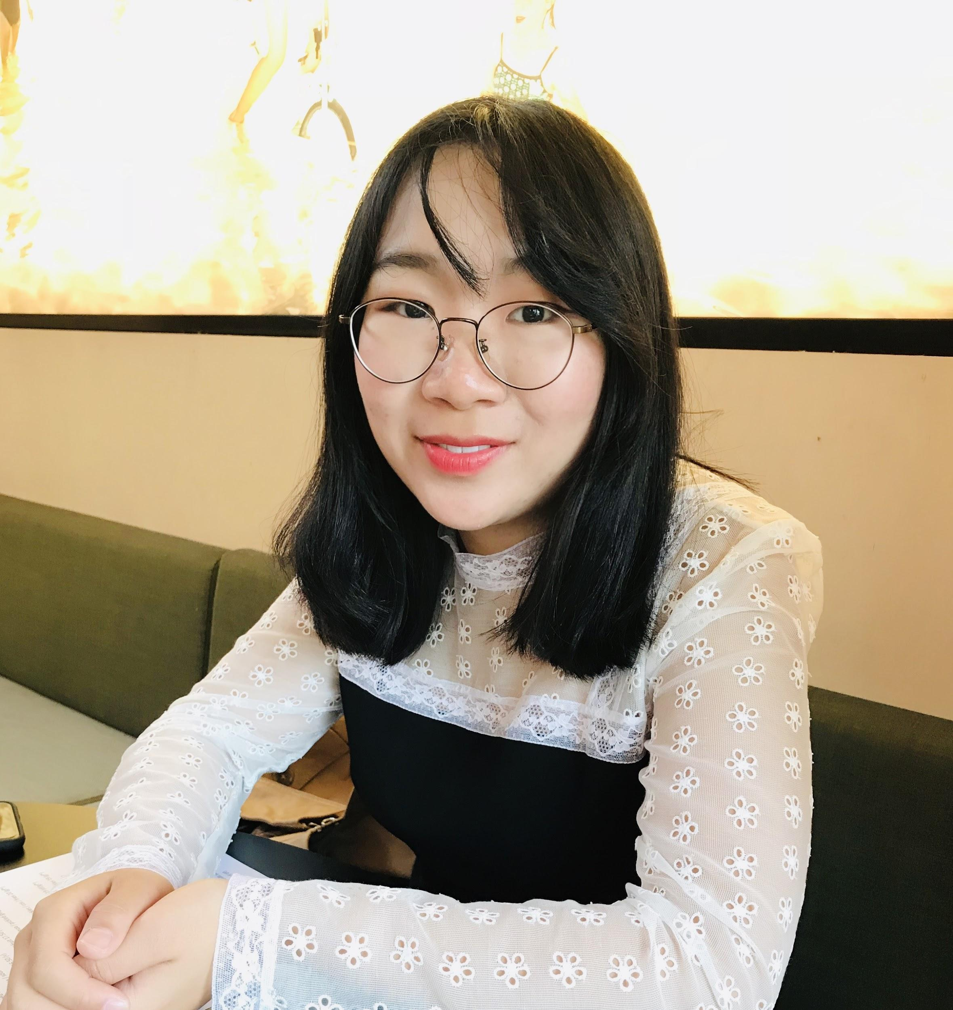
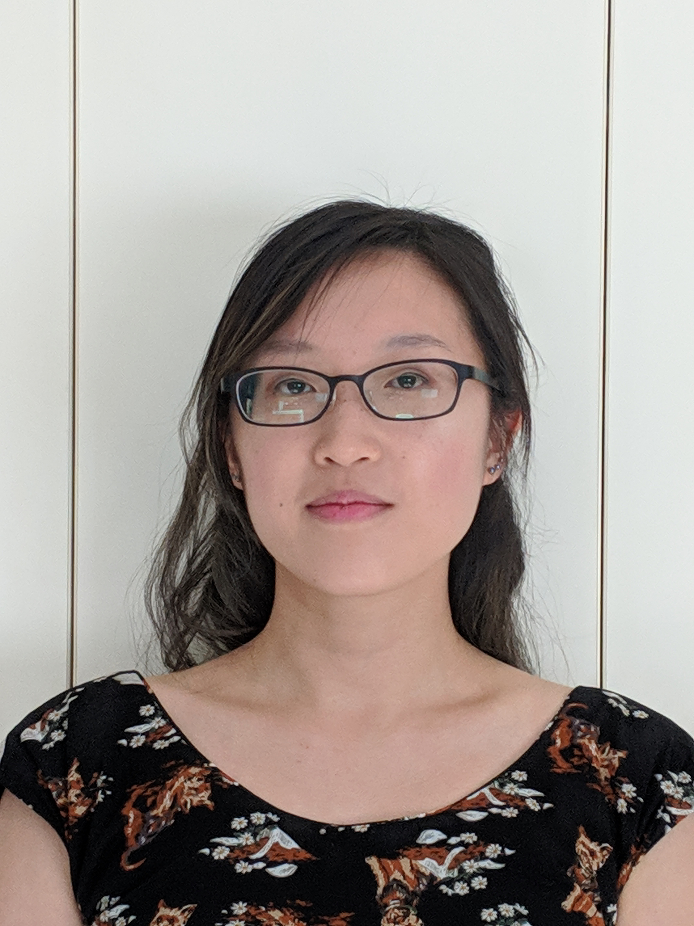
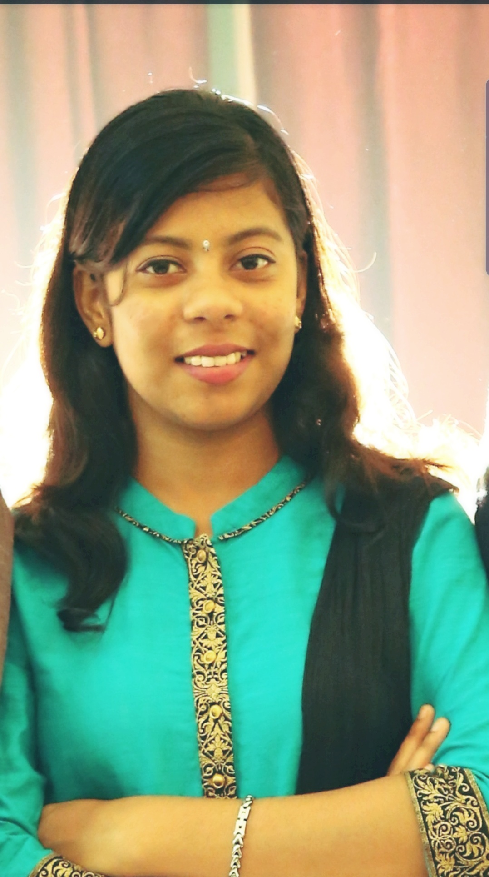
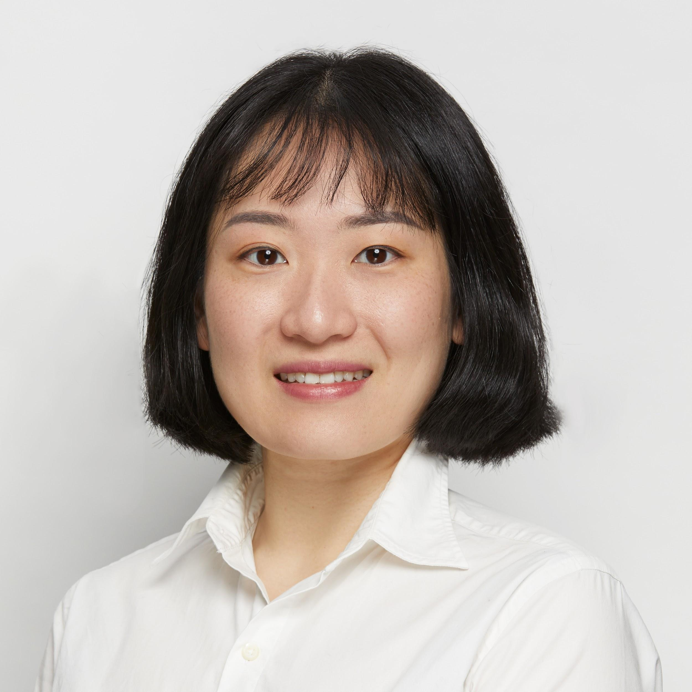
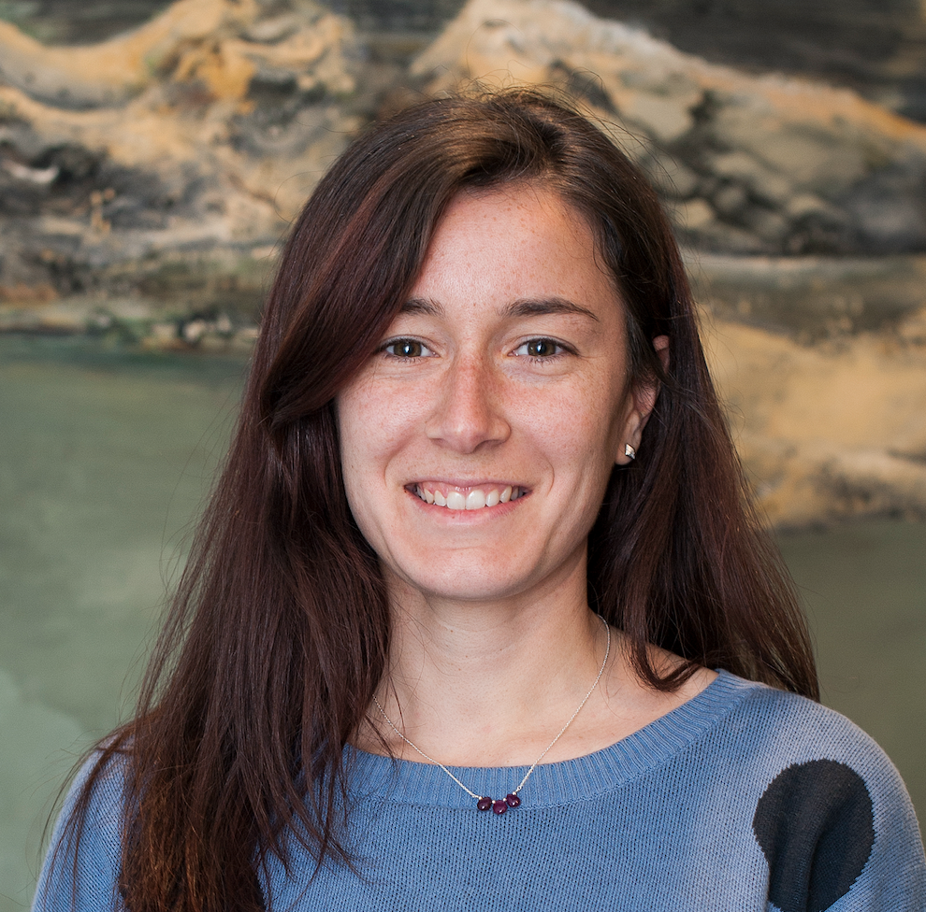
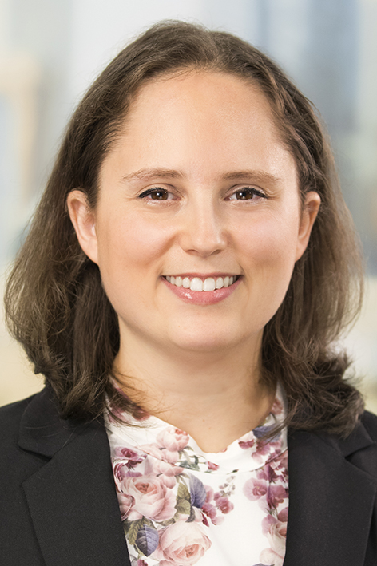

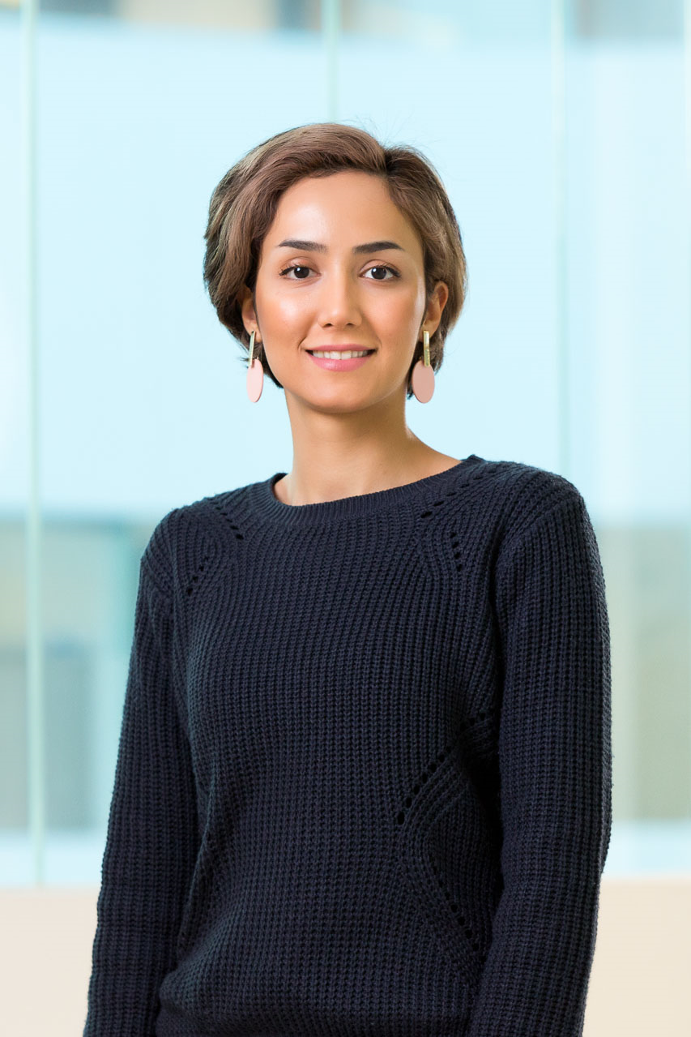
Introducing RLadies Melbourne Organising Committee 2020
Sehrish
Marie
Adele
Shazia
Alex
Dai Dai
Miriam
Shanmathi
Yuri
Anna
Nikki
Göknur
Sepideh

Slide 5





You can find us online
R-Ladies Melbourne
@RladiesMelb
@RladiesMelbourne

Slide 6
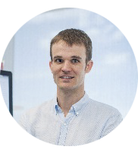



A big thank you
To our amazing and faithful sponsors
Matt Ritchie
Notes:
CSL provides funding for events, they extended their support for the next Zendesk/nous provides us space and drinks for some of our events, WEHI - occasional location for meetings and events

Slide 7

Welcome to Dr Virginia Liu
The development of Depth-Dependent Binocular Visual Fields Simulation and Visualization package.
The material of the event can be found at
Notes:
Virginia Liu is a Postdoc researcher at the Optometry and Vision Sciences Department of the University of Melbourne, a self-taught programmer and UX designer. She has a BMedSci and PhD in psychology.
Title & Abstract *
The development of Depth-Dependent Binocular Visual Fields Simulation and Visualization package.
Visual fields are measured monocularly at a single depth in clinical practice, yet real-life activities involve predominantly binocular vision at multiple depths. A simulation and visualisation tool that computes binocular visual fields from monocular ones is useful for researchers and clinicians in the field for many purposes. However, no such tool was available. The talk will provide an overview of the development of the R package and its CRAN submission process.

